Slide 1
100 Sports Image Classification Using EfficientNetB0 and ResNet50
Exploring Ensemble Learning and Fine-Tuning
By
John Yare
& Joshua Adegbola

Slide 2
Overview
Objective: Classify 100 sports image categories using an ensemble model by combining predictions of a Vision Transformer alternative model available in keras (EfficientNetB0) and ResNet50 model.
Models: EfficientNetB0 and ResNet50.
Dataset:
  Initial manipulated dataset had less training data.
  Reverted to baseline dataset for better performance and more variety of data in training.
Achievements:
  Achieved 92.6% test accuracy with EfficientNetB0 model.
  Achieved 96.2% test accuracy with ResNet50 model.
  Combined predictions from EfficientNetB0 and ResNet50 by optimizing weights for each model, based on each model's validation performances, into an ensemble model to improve the model's performance.
  Achieved 90% test accuracy with ensemble model.

Slide 3
Block Diagrams
Dataset loading
EfficientNetB0 Model Training
Ensemble evaluation
Training data
Validation data
Test data
Load ResNet50 model
- Load pre-trained EfficientNetB0 with ImageNet weights
- Freeze pretrained layers and add custom layers
- Train model using augmented training data with callbacks
Load EfficientNetB0 model
Preprocessed data
- Weighted averaging
- Combine predictions
ResNet50 Model Training
Calculate accuracy, F1, and confusion matrix
- Load Pre-trained ResNet50
- Freeze layers(Trainable Dense)
- Train model
-Evaluate Model(Test Accuracy)
Final result and visualization
- Print accuracy, F1, and metrics
- Plot confusion matrix, show predictions and errors
Block Diagram: Dataset Loading to Ensemble Evaluation

Slide 4
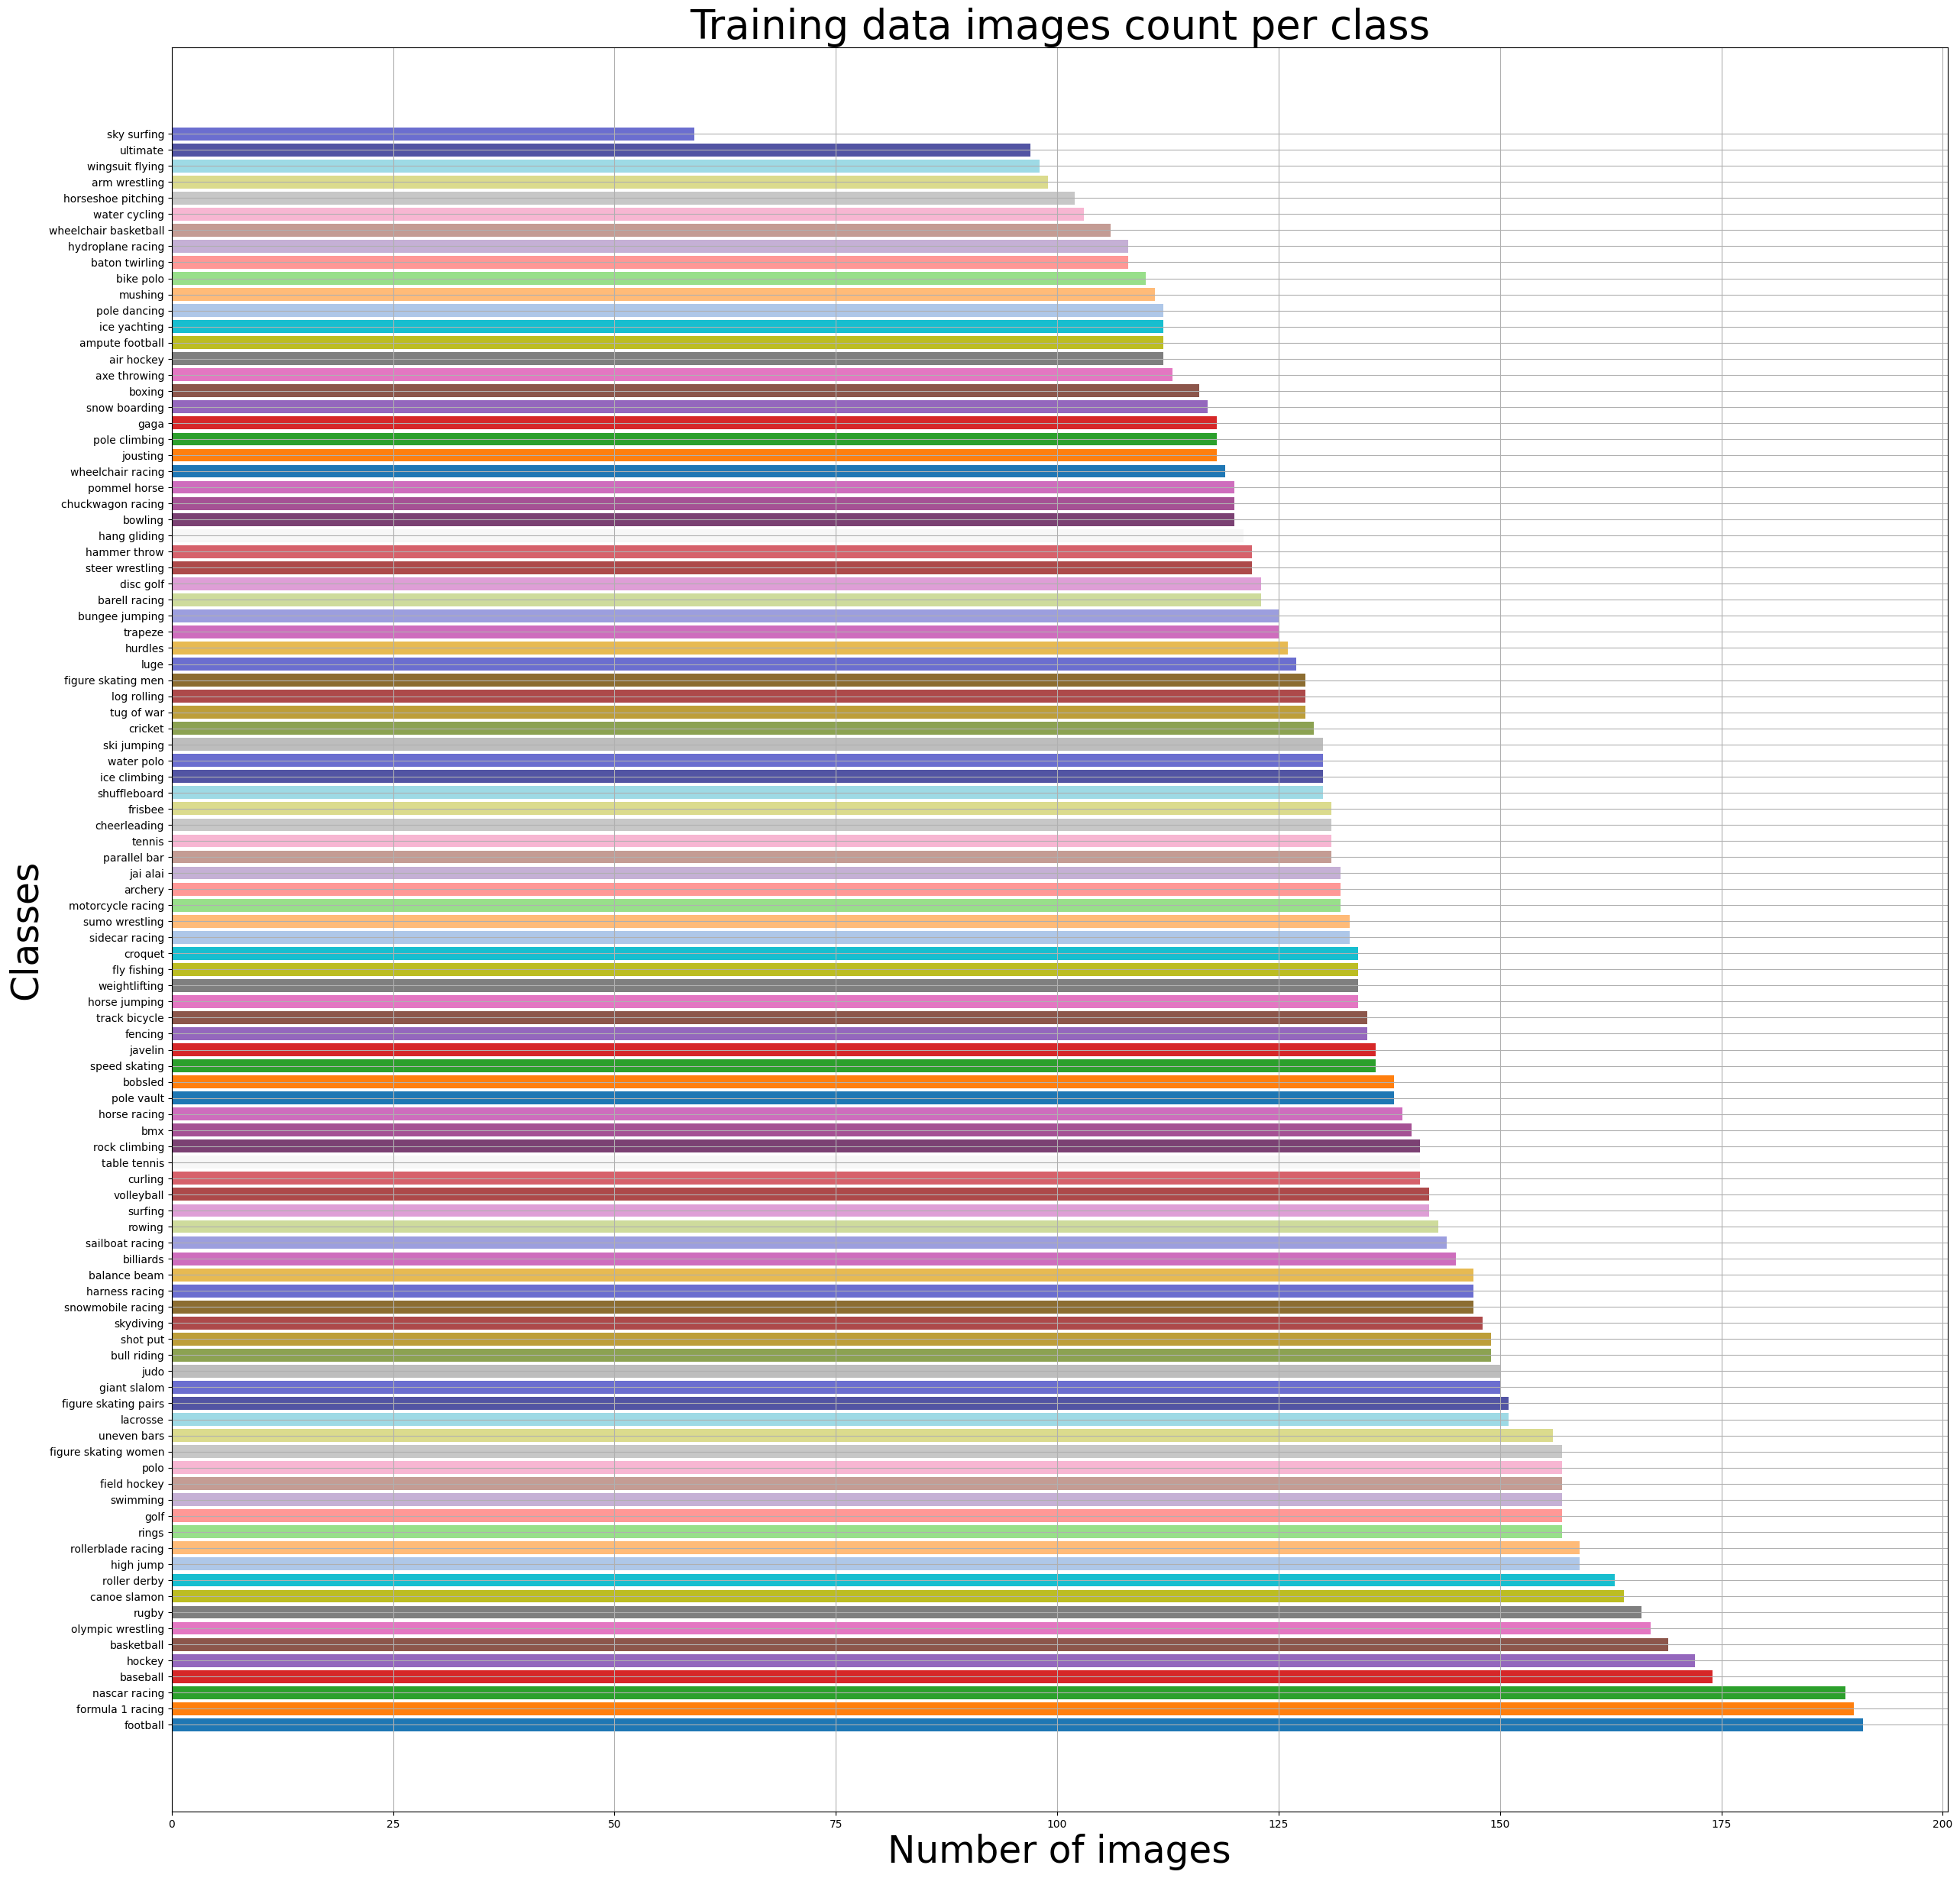
Dataset Preparation
Dataset paths for training, validation, and testing.
Used Label Encoder for class label encoding.
Visualized class distribution in training data.
Bar Chart: Image Count Per Class

Slide 5
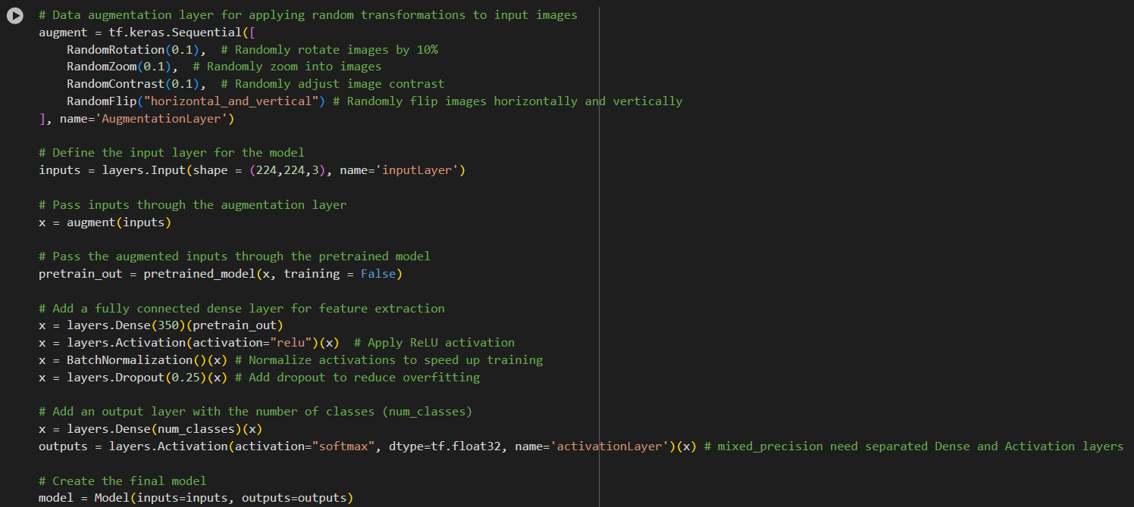
Data Preprocessing and Augmentation
Diagram: Augmentation Applied to Training Data Only
Challenges with direct augmentation:
    Reduced training and validation accuracy.
    Increased losses indicated no learning.
Solution:
    Augmentation applied after the input layer for training data only.

Slide 6
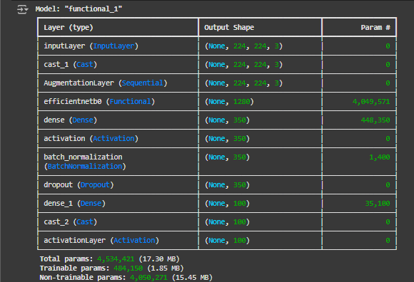
EfficientNetB0 Model Architecture
Base Model: Pretrained on ImageNet.
Custom Layers:
    Dense layers for feature extraction.
    Dropout for regularization.
    Batch Normalization for stability.
    Softmax activation for classification.
Fine-tuning with frozen Batch Normalization layers to avoid instability.
Diagram: Model summary

Slide 7
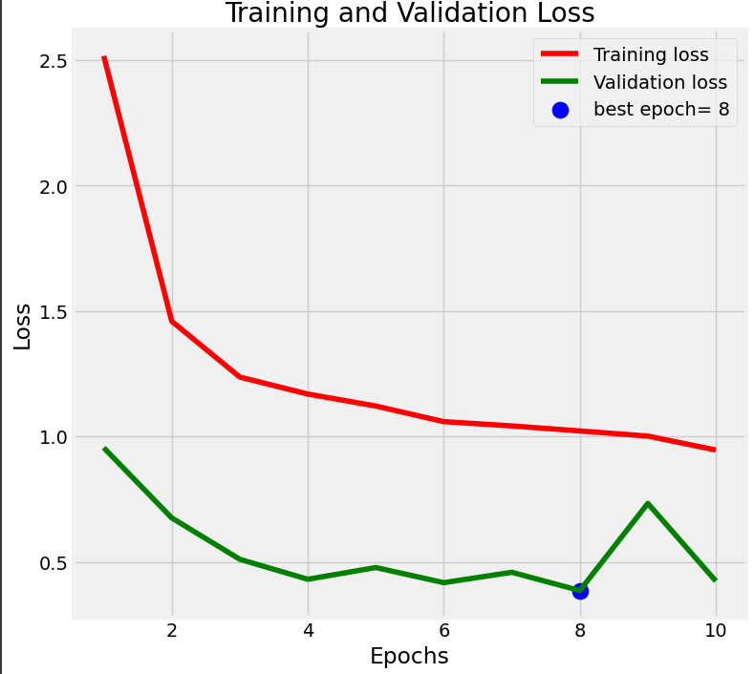
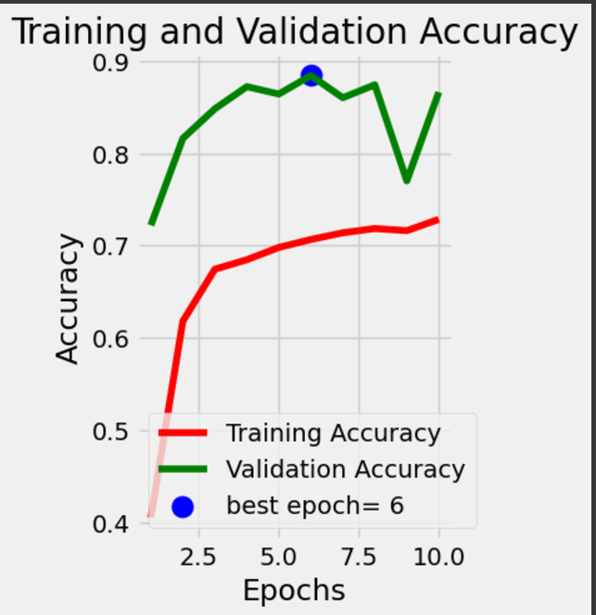
Training the EfficientNetB0 Model
Training settings:
    Optimizer: Adam (learning rate: 0.0005).
    Batch size: 10.
    Epochs: 10.
Callbacks:
    EarlyStopping to prevent overfitting.
    ReduceLROnPlateau for dynamic learning rate adjustment.
Results:
    Improved training and validation performance.
Plots: Training and Validation Loss/Accuracy

Slide 8
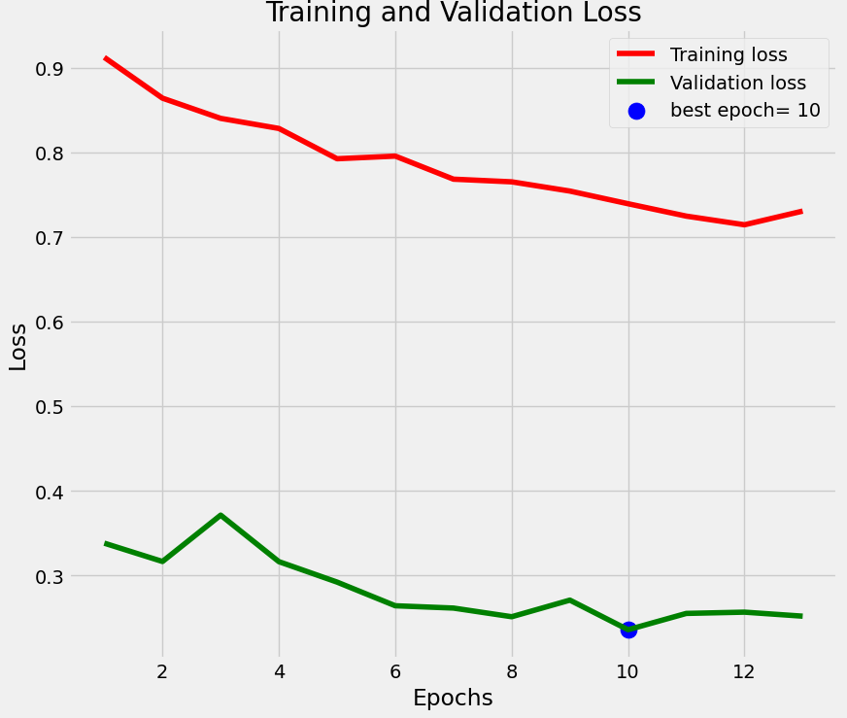
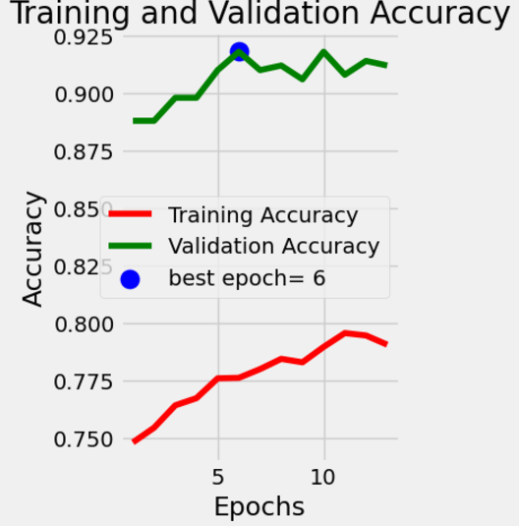
Fine-Tuning the EfficientNetB0 Model
Unfroze EfficientNetB0 layers while freezing BatchNormalization.
Reduced learning rate to 0.0001 for stability.
Reused EarlyStopping and ReduceLROnPlateau callbacks.
Results:
    Further improvement in validation accuracy and loss reduction.
Fine-tuned Training and Validation Performance Plots

Slide 9
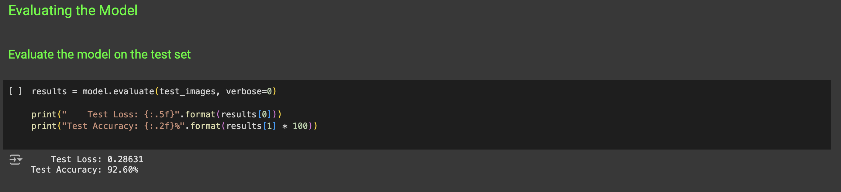
Test accuracy performanxe for EfficientNetB0 model

Slide 10
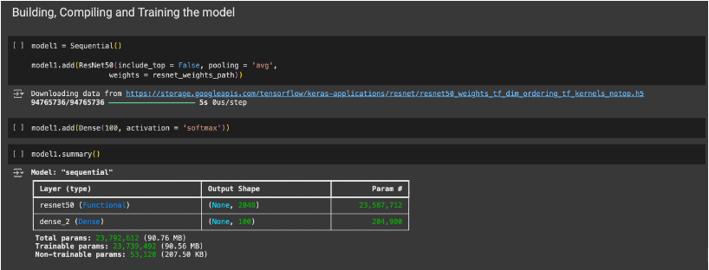
Model Architecture: ResNet50
Base Model: ResNet-50 pretrained on ImageNet.
Output Layer: Dense Layer with 100 softmax nodes for classification
Freezing ResNet-50 layers for transfer learning.

Slide 11
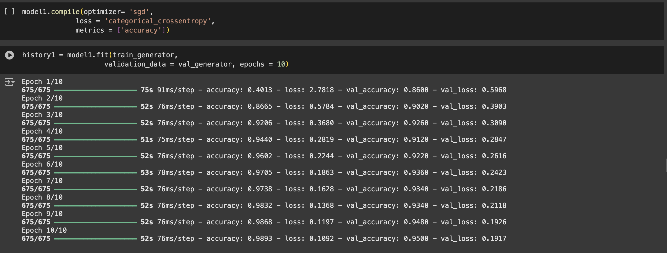
Training Setup
Loss Function: Categorical Crossentropy.
Optimizer: SGD (Stochastic Gradient Descent).
Metrics: Accuracy.
Training for 10 epochs using train and validation datasets.

Slide 12
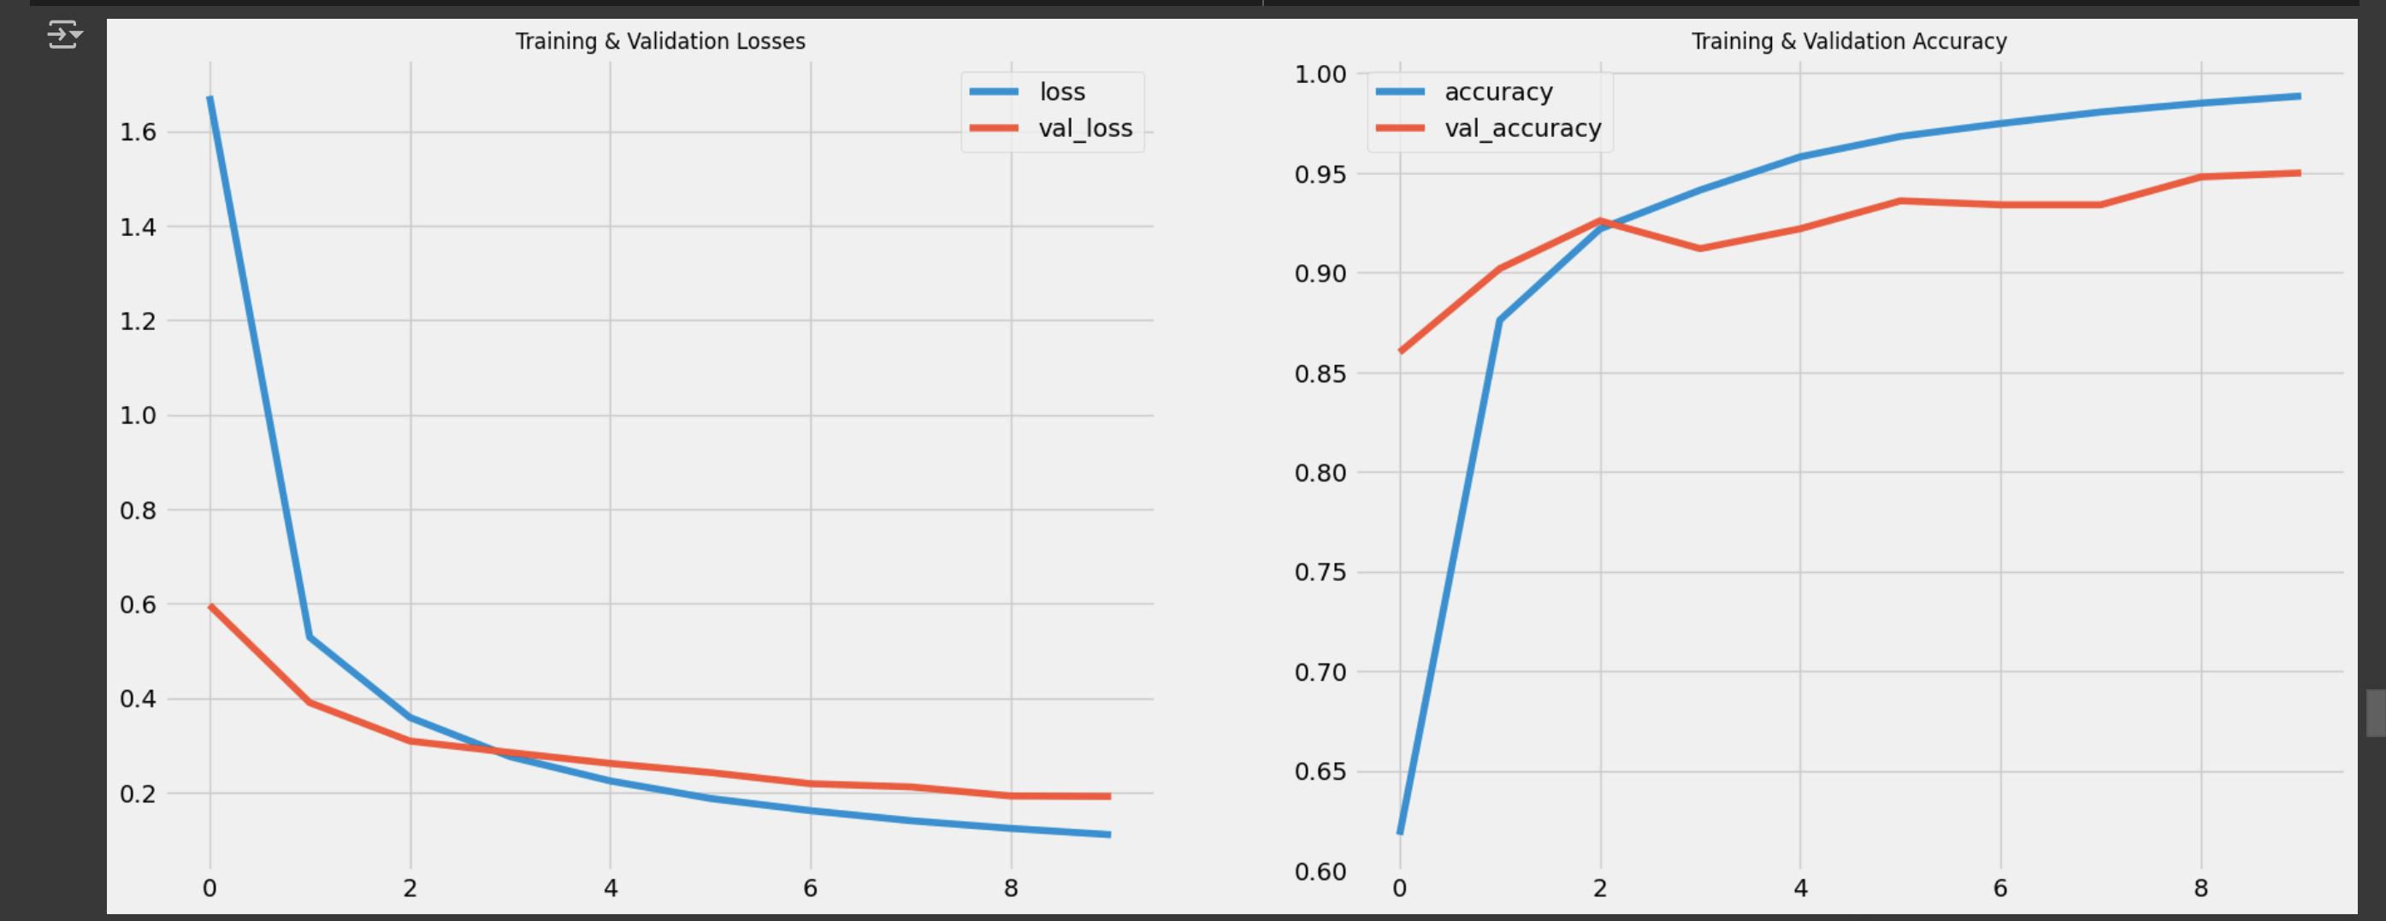
Result Visualization
Results:​
    Improved training and validation performance accuracy

Slide 13
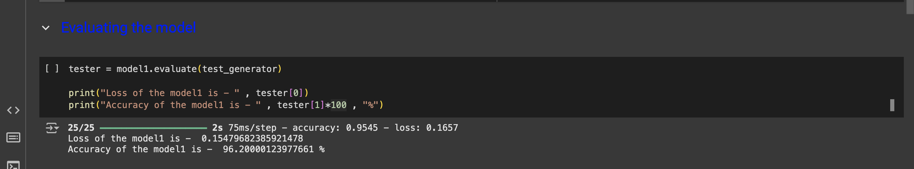
Model evaluation
Metrics Used
Loss: Measures the error during the evaluation process.
  Lower loss values indicate better model predictions.
  Example from the evaluation:
    Loss = 0.1547
Accuracy: Percentage of correct predictions made by the model.
  High accuracy indicates the model is correctly classifying most of the input images.
  Example from the evaluation:
    Accuracy = 96.20%

Slide 14
Combining EfficientNetB0 and ResNet50 Predictions
Ensemble Method:
    Weighted averaging of predictions from both models.
    EfficientNetB0 and ResNet50 assigned weights based on each model's validation and prediction performances.
Results:
    Achieved a high performance from combined predictions in ensemble model.
Advantages:
    Leverages strengths of both models.
    Reduces individual model biases and overfitting in general.
    Improves generalization, which makes the combined model likely perform better on unseen data compared to a single model.

Slide 15
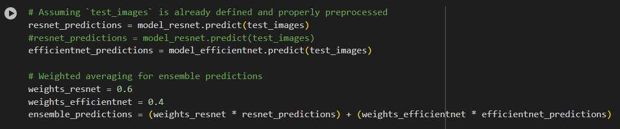
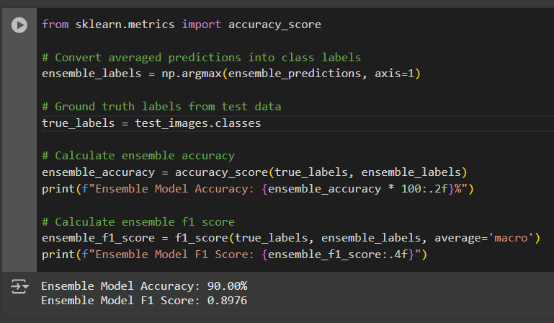
Diagram: Ensemble Prediction Process

Slide 16
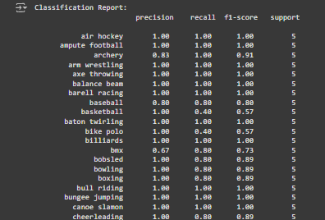
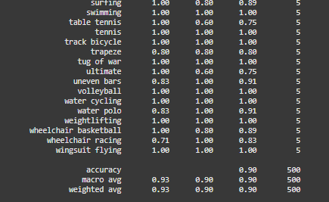
Evaluation Metrics for Ensemble Model
Achieved Accuracy: 90%.
Metrics explained:
    Precision: True positives among predicted positives.
    Recall: True positives among actual positives.
    F1-Score: Balances precision and recall.
    Confusion Matrix: Breakdown of true vs. predicted classes.
Snippet of Ensemble model Classification Report

Slide 17
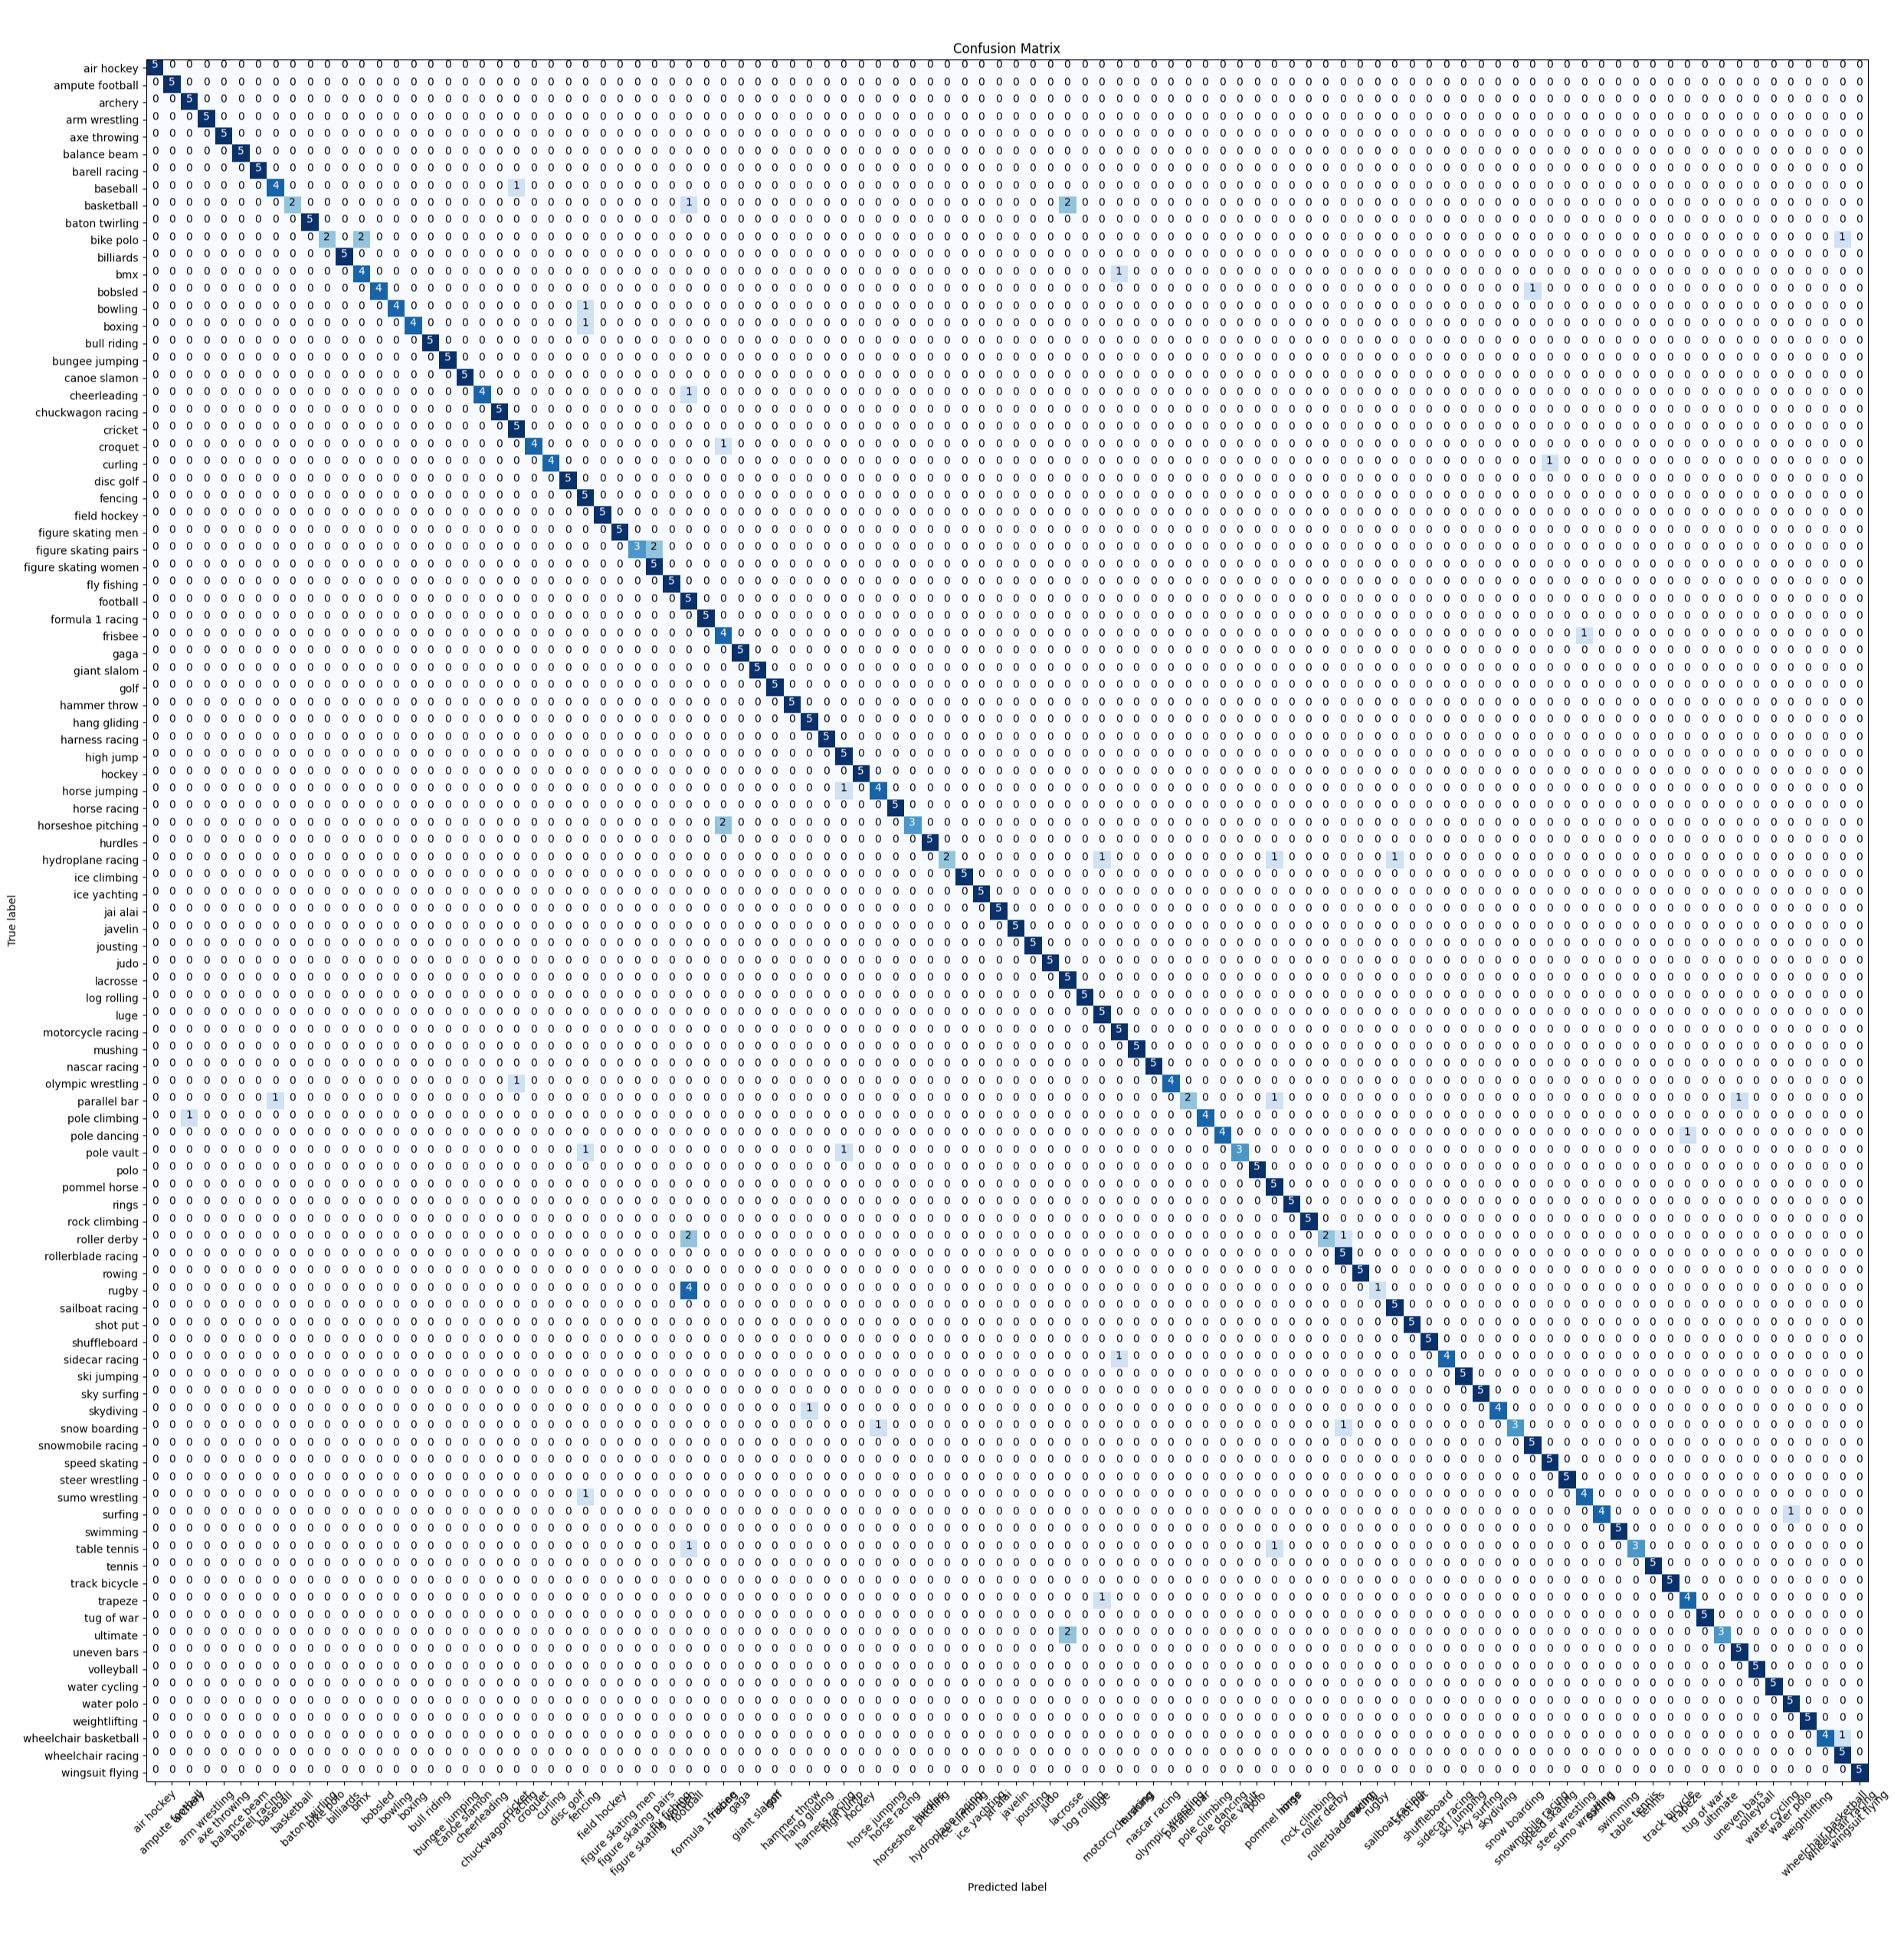
Visualizing Predictions
Visualized predictions from EfficientNetB0, ResNet50, and ensemble model.
Highlighted misclassifications with high confidence.
Grid: True Labels vs. Predictions

Slide 18
Summary and Key Takeaways
EfficientNetB0 and ResNet50 proved effective for sports image classification.
Ensemble learning improved generalization, and robustness.
Future Work:
    Experiment with different ensemble strategies.
    Test on larger datasets.

Slide 19
REFERENCES
100 Sports Image Classification. (2023, May 3). Kaggle. https://www.kaggle.com/datasets/gpiosenka/sports-classification/data
Affonso, C., Rossi, A. L. D., Vieira, F. H. A., & de Leon Ferreira, A. C. P. (2017). Deep learning for biological image classification. Expert systems with applications, 85, 114-122.
Hamedghorbani. (2023b, July 17). 100 Sports Classification - EfficientNetB0 | 97.8%. Kaggle. https://www.kaggle.com/code/hamedghorbani/100-sports-classification-efficientnetb0-97-8
Ishaparanjpe. (2023, April 19). sports classification RESNET transfer learning. Kaggle. https://www.kaggle.com/code/ishaparanjpe/sports-classification-resnet-transfer-learning/notebook
Liu, X. (2024). Comparison of Four Convolutional Neural Network-Based Algorithms for Sports Image Classification. In Advances in intelligent systems research/Advances in Intelligent Systems Research (pp. 178–186). https://doi.org/10.2991/978-94-6463-370-2_20
Podgorelec, V., Pečnik, Š., & Vrbančič, G. (2020). Classification of Similar Sports Images Using Convolutional Neural Network with Hyper-Parameter Optimization. Applied Sciences, 10(23), 8494. https://doi.org/10.3390/app10238494

